Slide 1
Constructor injection Vs. Setter injection
Spring supports two types of injection Setter Injection which uses POJO’s(getters and setters) for injecting and the other type is Constructor Injection which uses constructors for injection. Both approaches of injection have their own pros and cons.

Slide 2
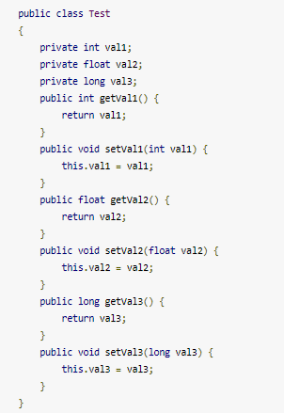

Constructor injection Vs. Setter injection
1. Partial Injection
In Setter injection partial injection is possible, Suppose if we have 3 dependencies like int, float and long. If we have not injected the values for any of the primitive then it will take default value for it.
In constructor injection, it is not possible as we cannot call a constructor without the matching parameters.
We have Test class with a int, float and long primitives and their corresponding POJO’s, In our Spring configuration file, we will inject partially.

Slide 3
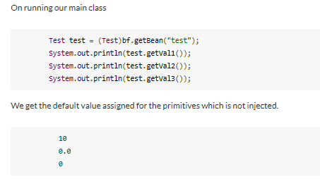
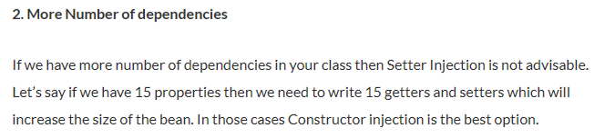
Constructor injection Vs. Setter injection

Slide 4
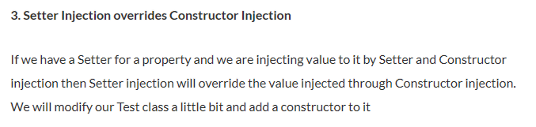
Constructor injection Vs. Setter injection

